Slide 1
C Programming

Slide 2
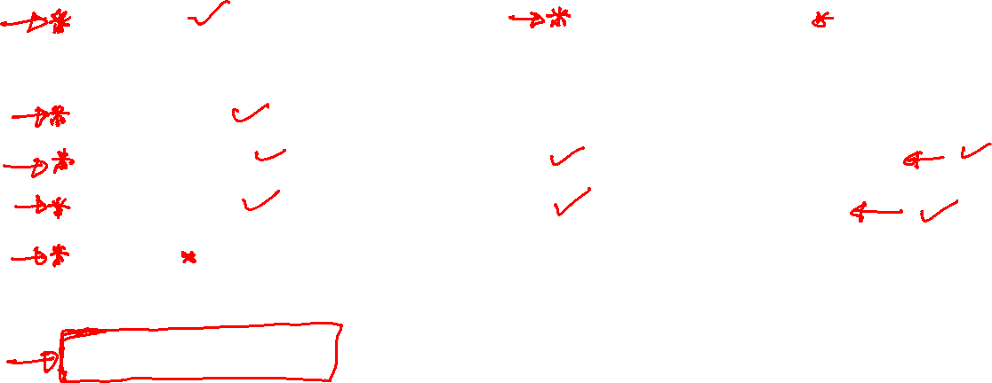


Programming Basics
Syntax
Comments
Variables
Data types
Operators
If else
Switch
Loops(for/while)
Break/Continue
Arrays
Strings
Display Output (printf)
User Inputs (scanf)
Functions
Structures
File Handling

Slide 3
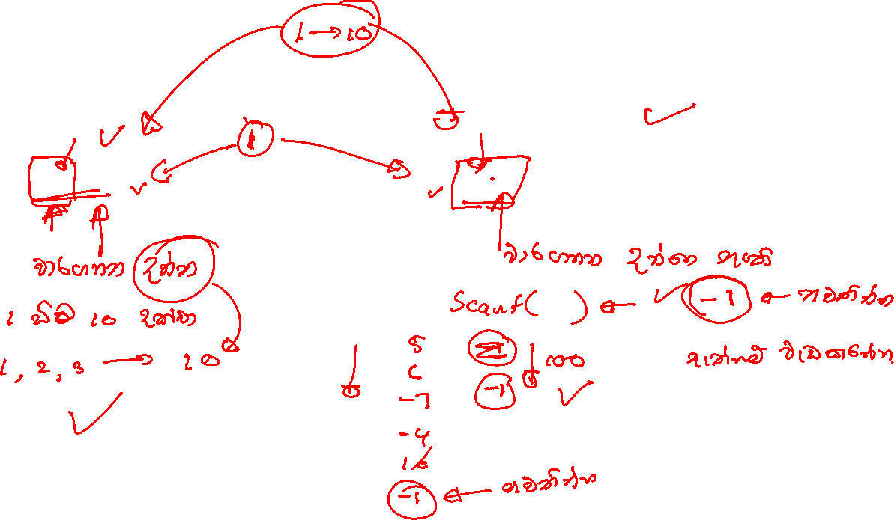
What is the purpose of using loops?
For Loop
While Loop

Slide 4
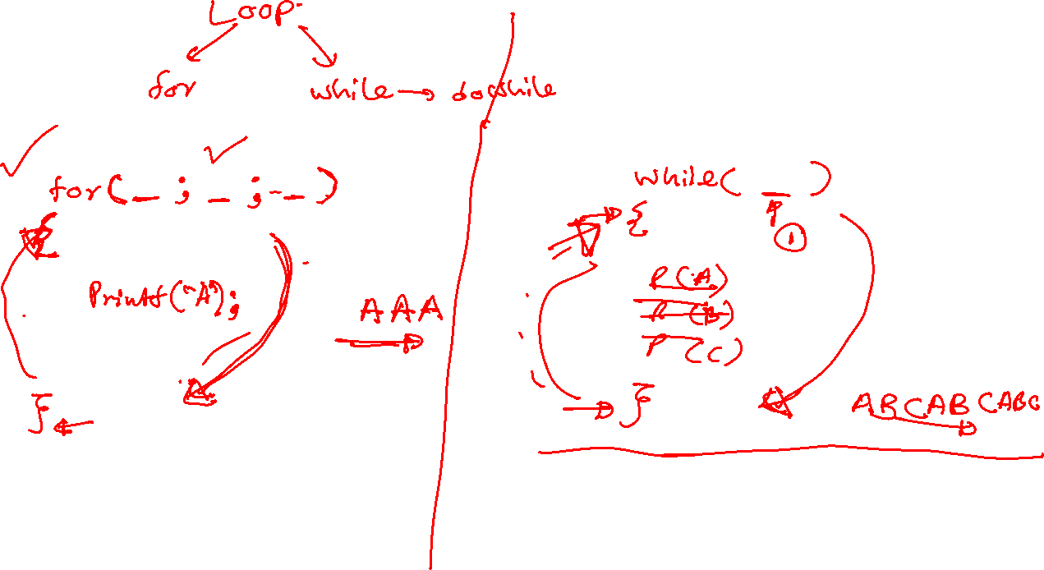

Slide 5
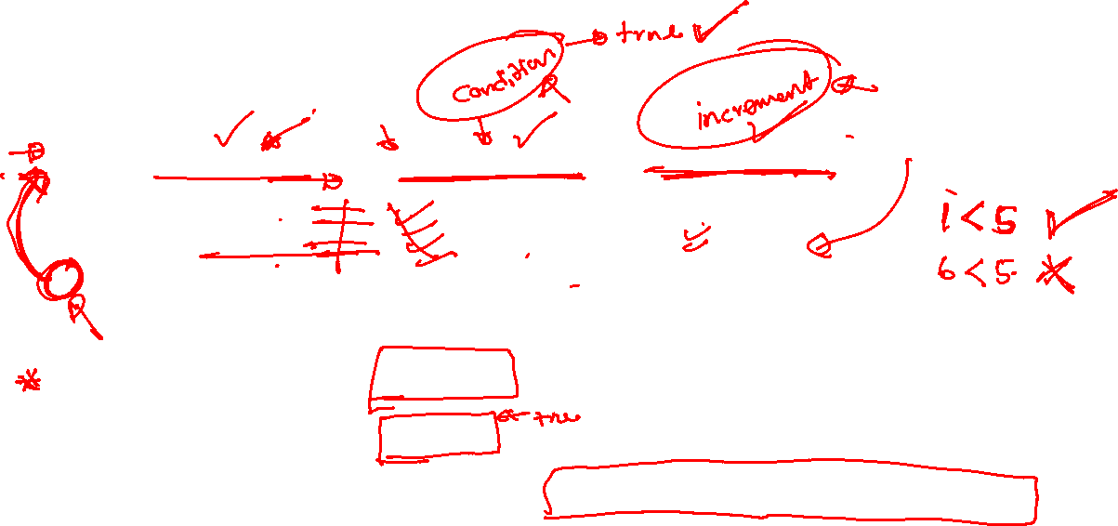
For Loop syntax
for (statement 1; statement 2; statement 3) {
// code block to be executed }
Statement 1 is executed (one time) before the execution of the code block.
Statement 2 defines the condition for executing the code block.
Statement 3 is executed (every time) after the code block has been executed.

Slide 6
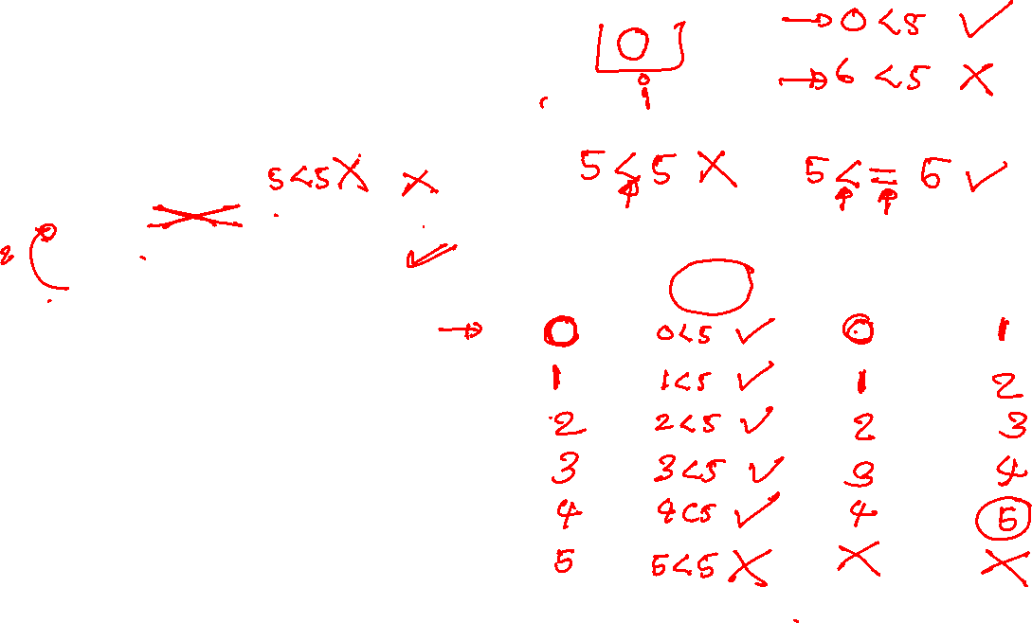
For Loop Example
int i;
for (i = 0; i < 5; i++) { printf("%d\n", i); }
i | I < 5 | block | i++

Slide 7
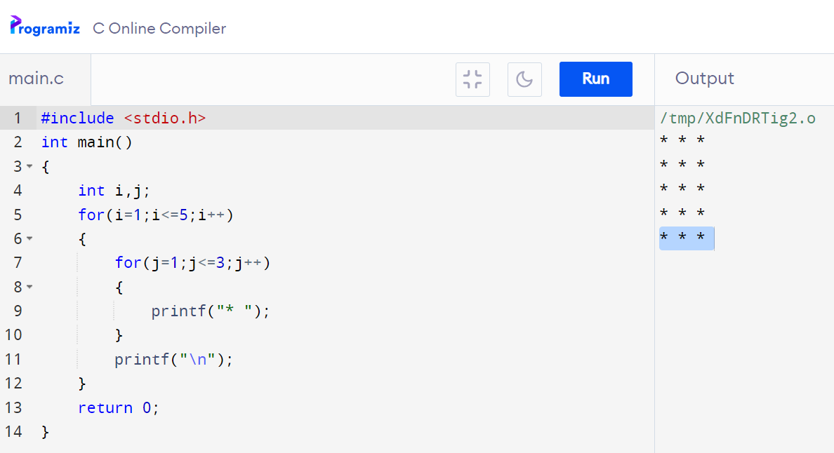









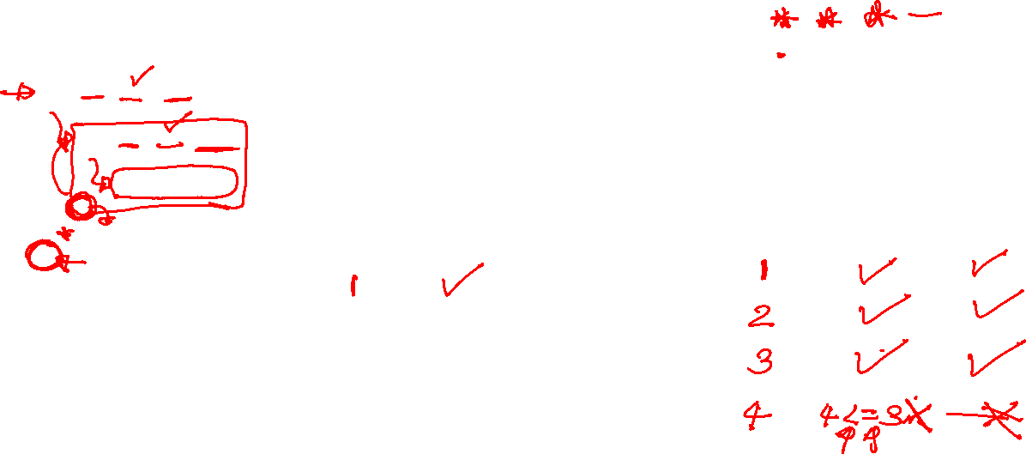





































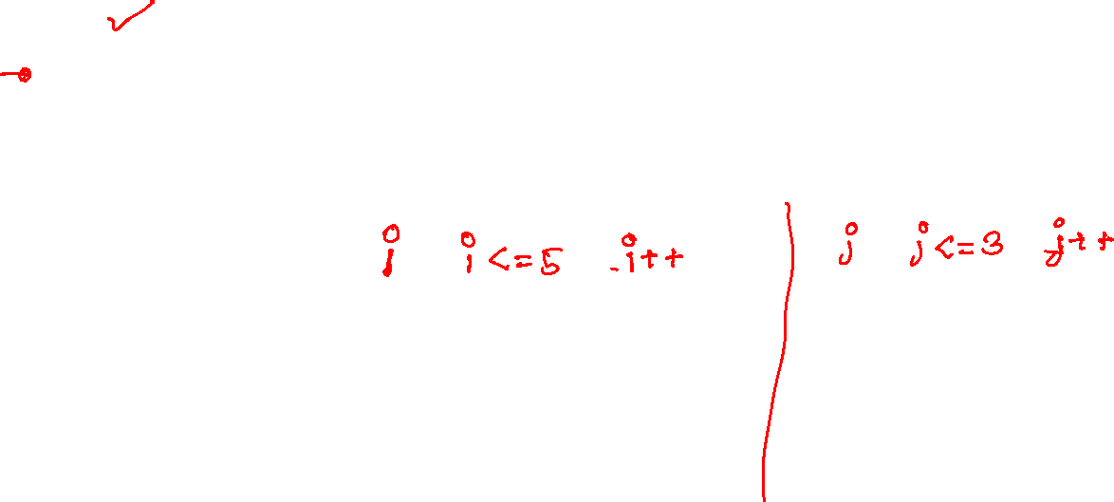


Slide 8
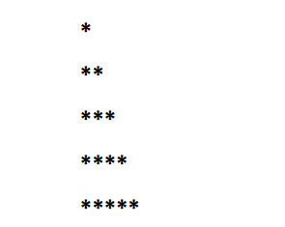
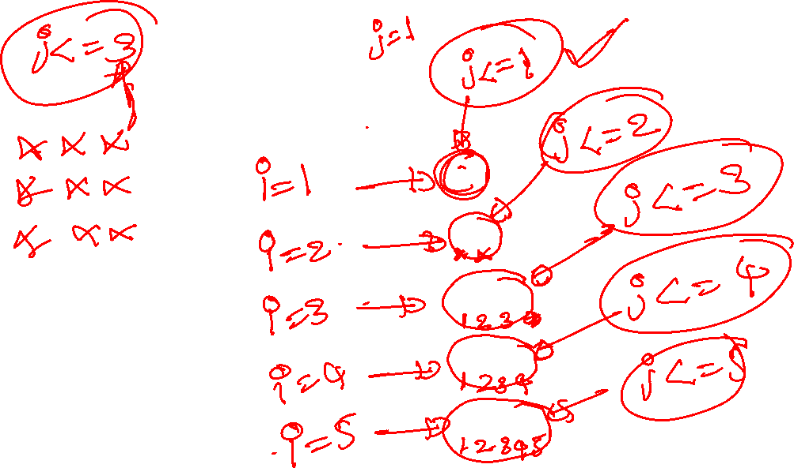

Slide 9
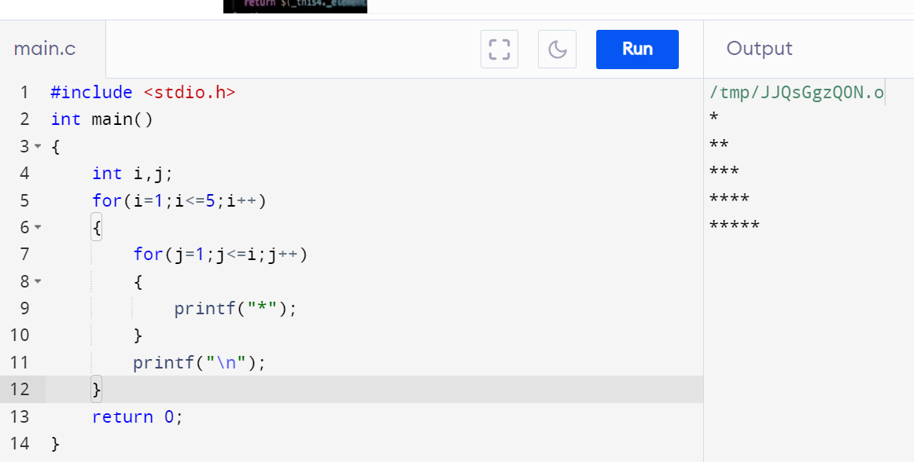












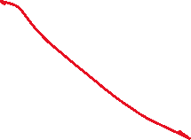



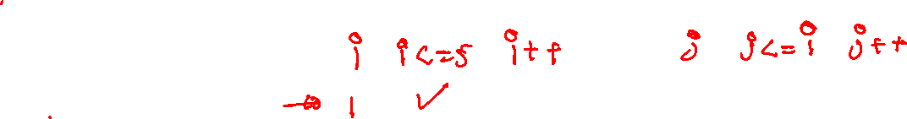

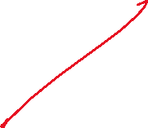







Slide 10
While Loop Syntax
while (condition) { // code block to be executed }
Check condition before execute code block

Slide 11
















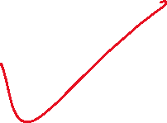



While loop Example
int i = 0; while (i < 5) { printf("%d\n", i); i++; }
i | I < 5 | block | i++

Slide 12
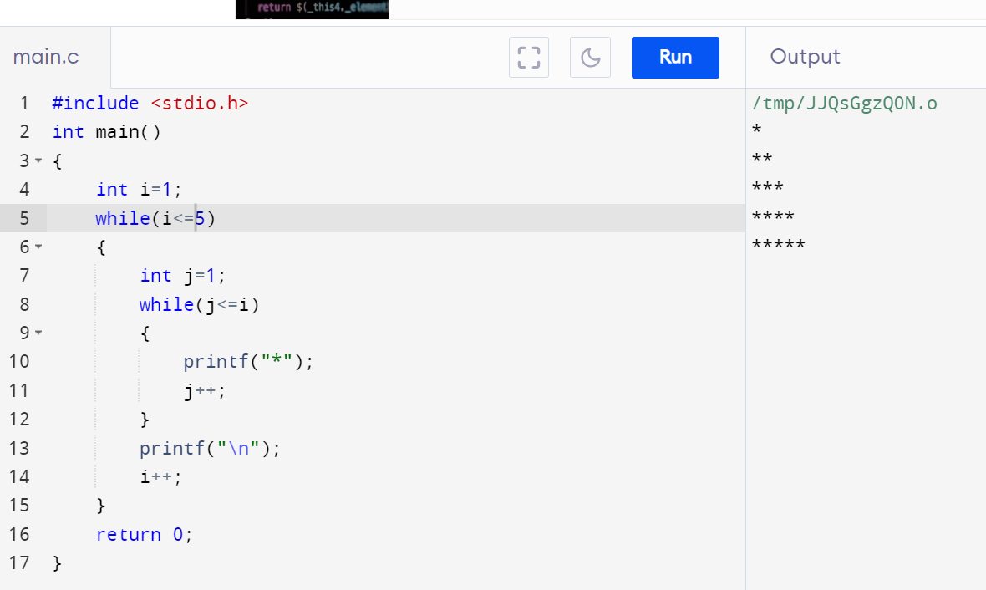
















Slide 13
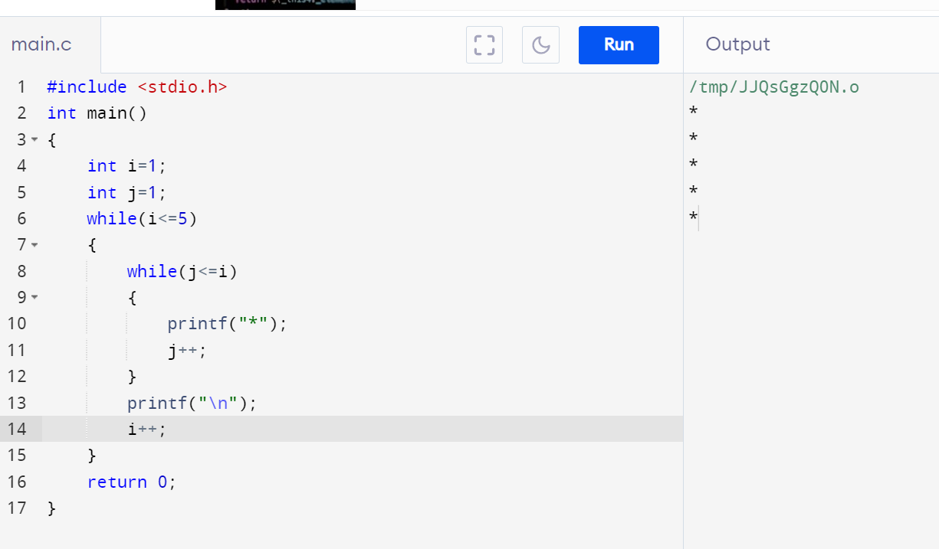








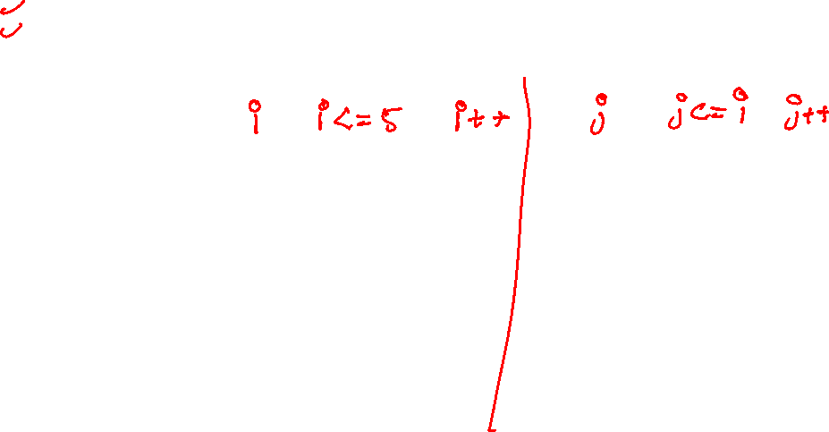


Slide 14
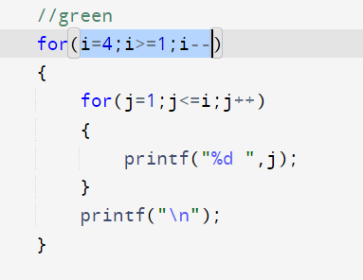














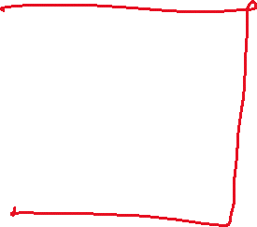

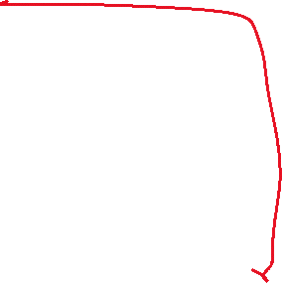













Slide 15
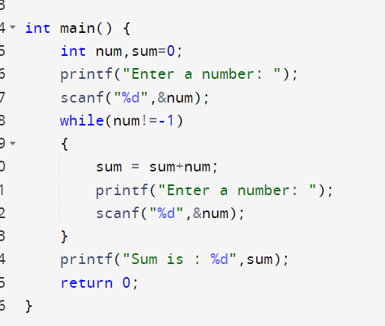
















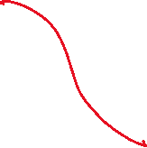











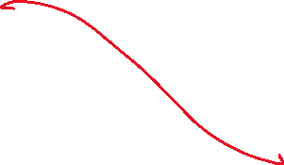


Slide 16
Do While Loop Syntax
Do{
// code block to be executed
} while(condition);
Check condition after execute code block

Slide 17











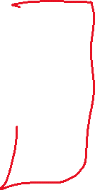














Do While loop Example
int i = 0; do{ printf("%d\n", i); i++; }while(i < 5);
i | I < 5 | block | i++

